Slide 1
FULLSTACK
Backend Programming

Slide 2
Multiple Return Function

Slide 3
Multiple Return Function
Have a multiple return value

Slide 4
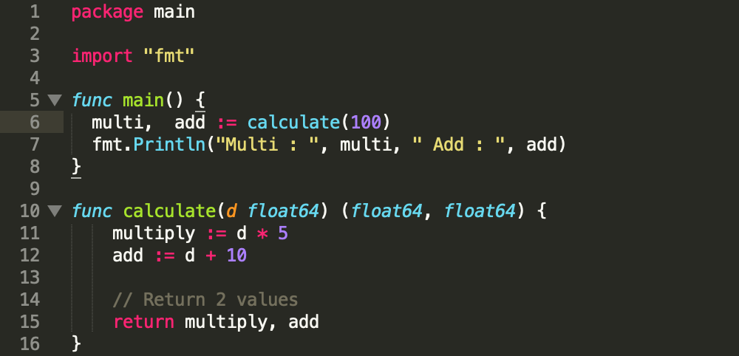
Multiple Return Function

Slide 5

Let’s try !
Make a multiple return value of your full name. There are 2 parameter. func myFullName(firstName string, lastName string) (string, string) {
do your code
}

Slide 6
Variadic Function

Slide 7
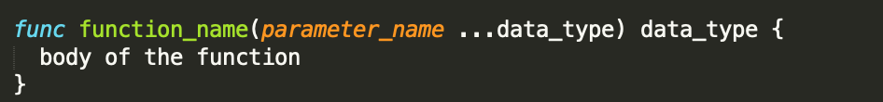
Variadic Function
It’s a function that has an unlimited parameter

Slide 8
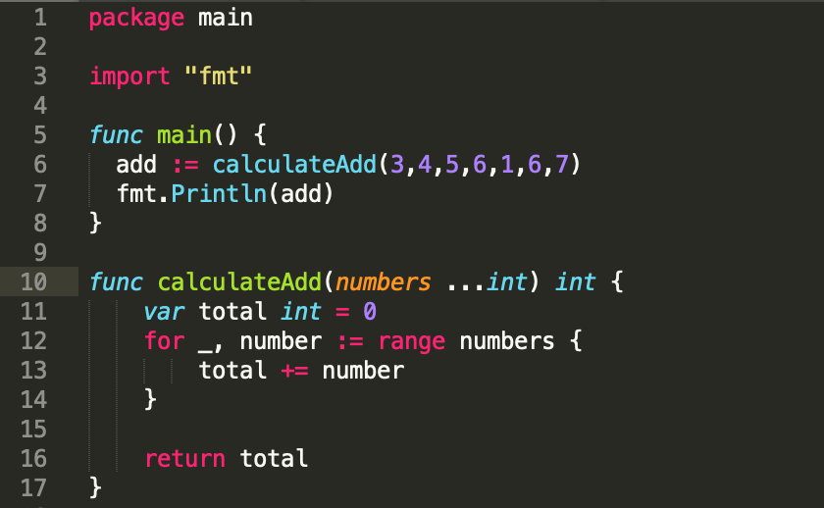
Variadic Function

Slide 9
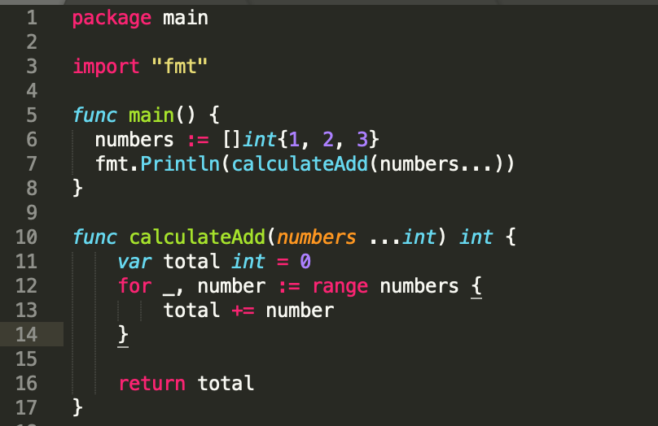
Let’s try !
According to the last code, put the input into the slice in main function

Slide 10
Clousure Function

Slide 11
Closure Function
Closure is a function that is saved in variable
Be able to implement function in function
Can be called anonymous function

Slide 12
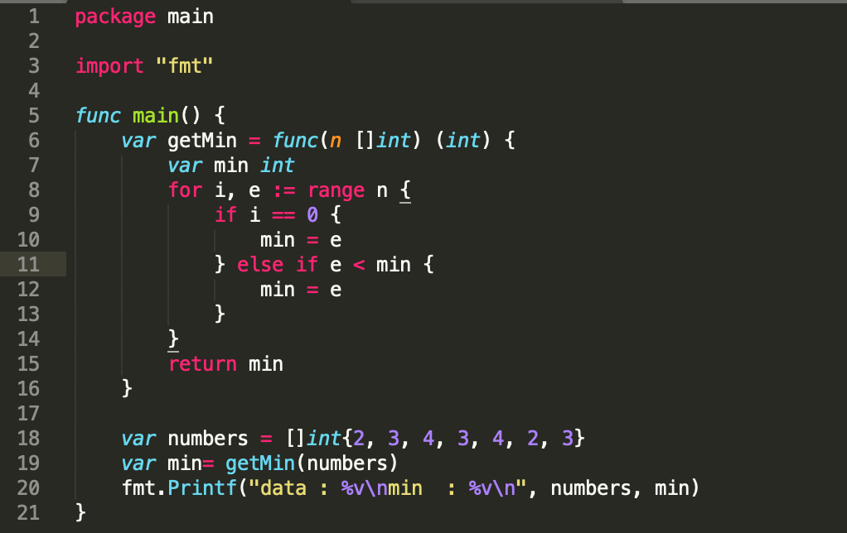
Closure Function - Variable

Slide 13
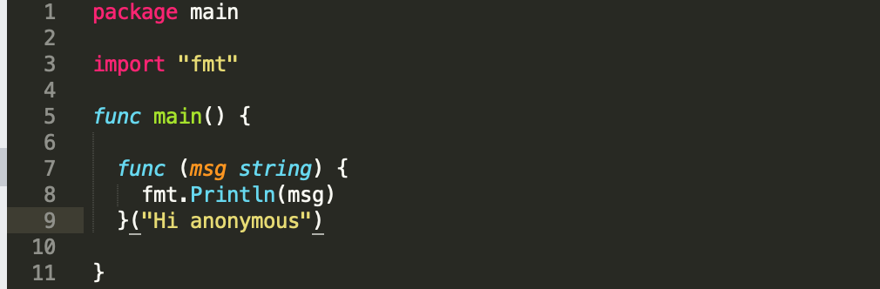
Closure Function - Anonymous

Slide 14
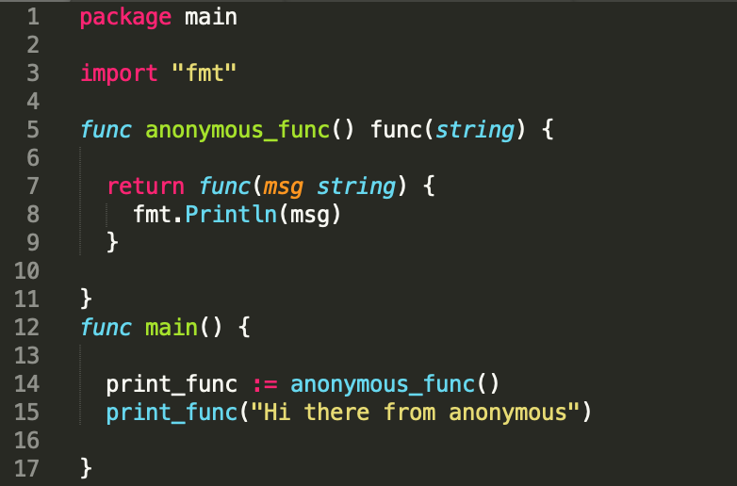
Closure Function

Slide 15
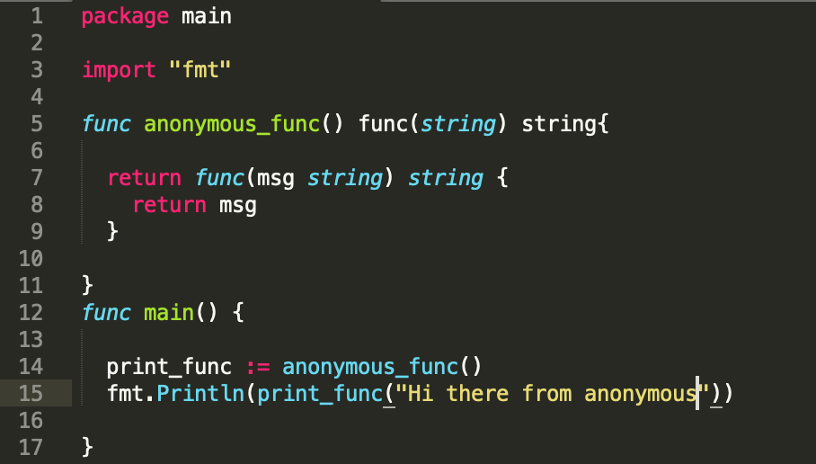
Let’s try !
According to the last code: 1. Change the return anonymous_func to return msg not fmt.Println. 2. put fmt.Println(print_func(“Hi there anonymous”))

Slide 16
Summary
Multiple Return Function
Variadic Function
Closures Function

Slide 17


